Slide 1


Healthcare Infrastructure Intelligence Dashboard
JAN 2024
Daise
Larissa
Lidiane
Lucas
Maisa
Vinicius

Slide 2
SUMARY DESCRIPTION
Where would be the best location in London to establish a public services center?
The city of London is currently facing a challenge in deciding the best locations to build new health centers. To make this decision, Planner Churchill needs to conduct a thorough analysis that takes into account various socioeconomic indicators. The goal is to ensure that all residents have access to healthcare, regardless of their location, and that public resources are utilized efficiently and effectively. Community participation is a crucial aspect of this decision-making process. Mr. John Citizen represents an average Londoner who wants to ensure that the city's healthcare system is equitable and accessible to everyone.

Slide 3
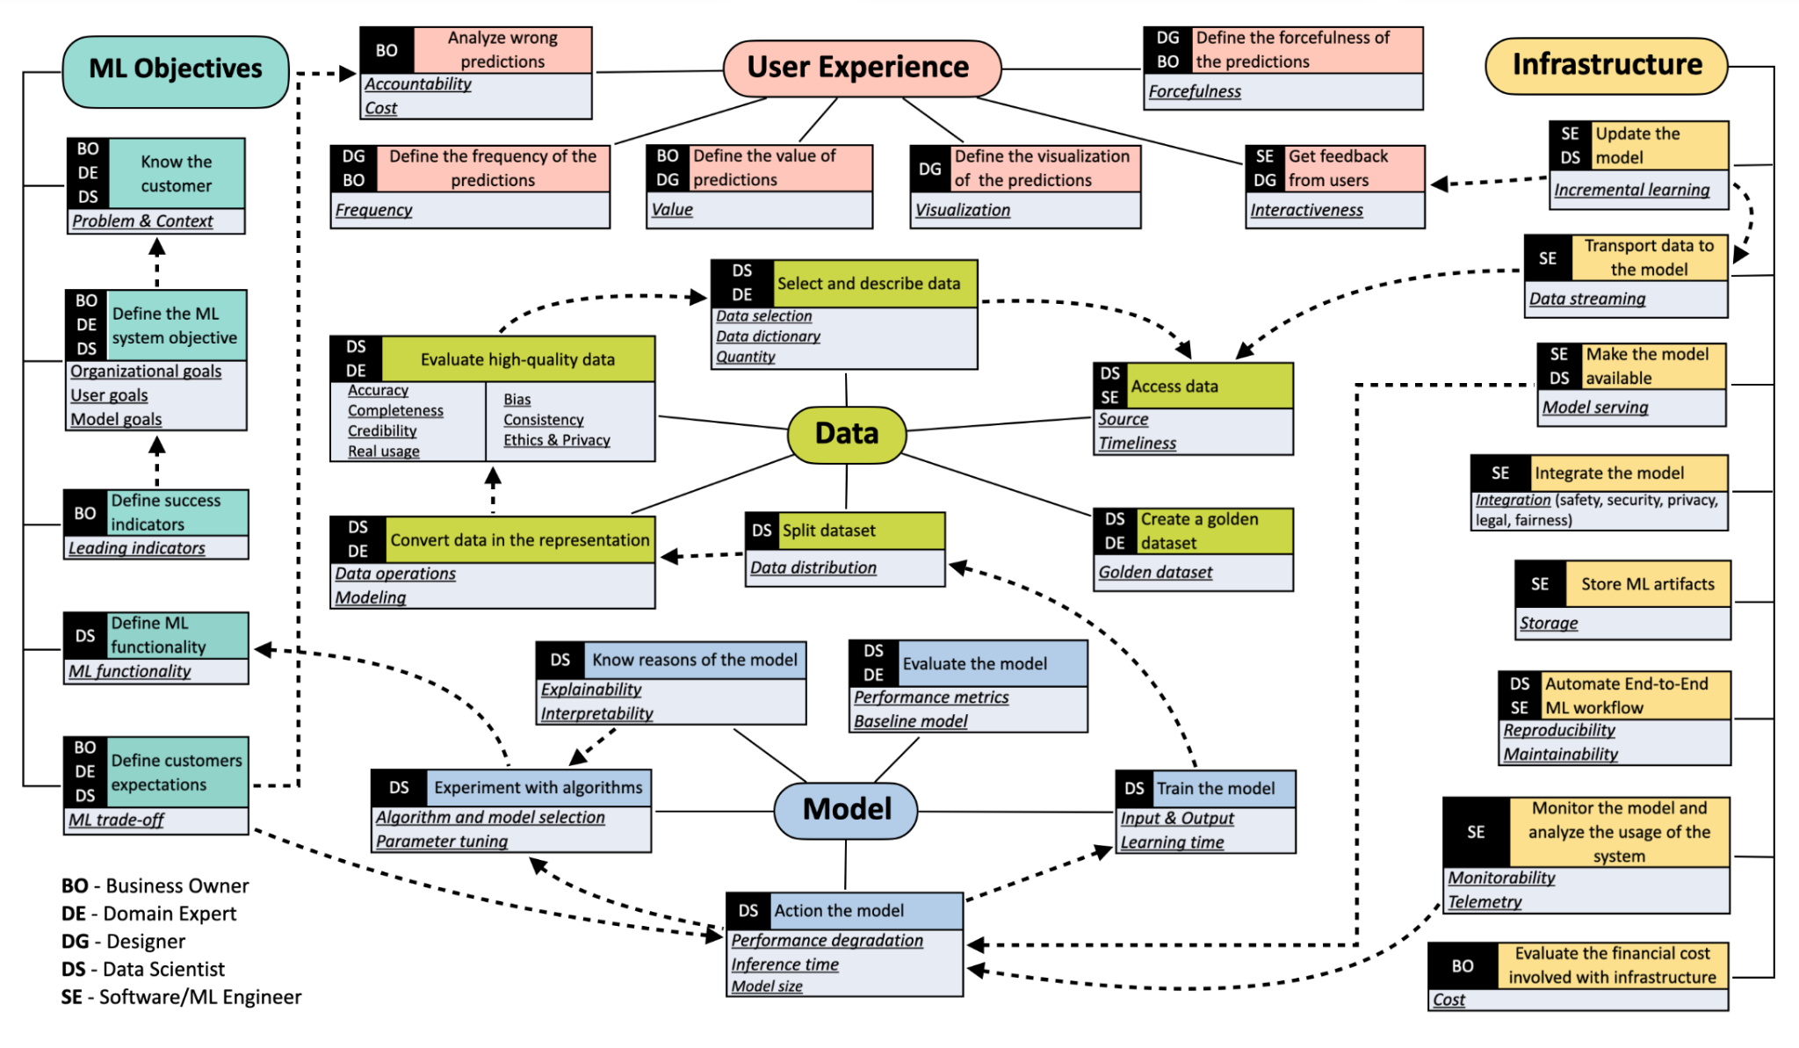
PerSpecML

Slide 4
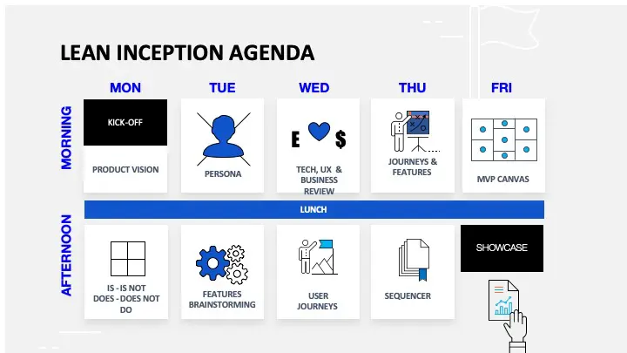

Slide 5
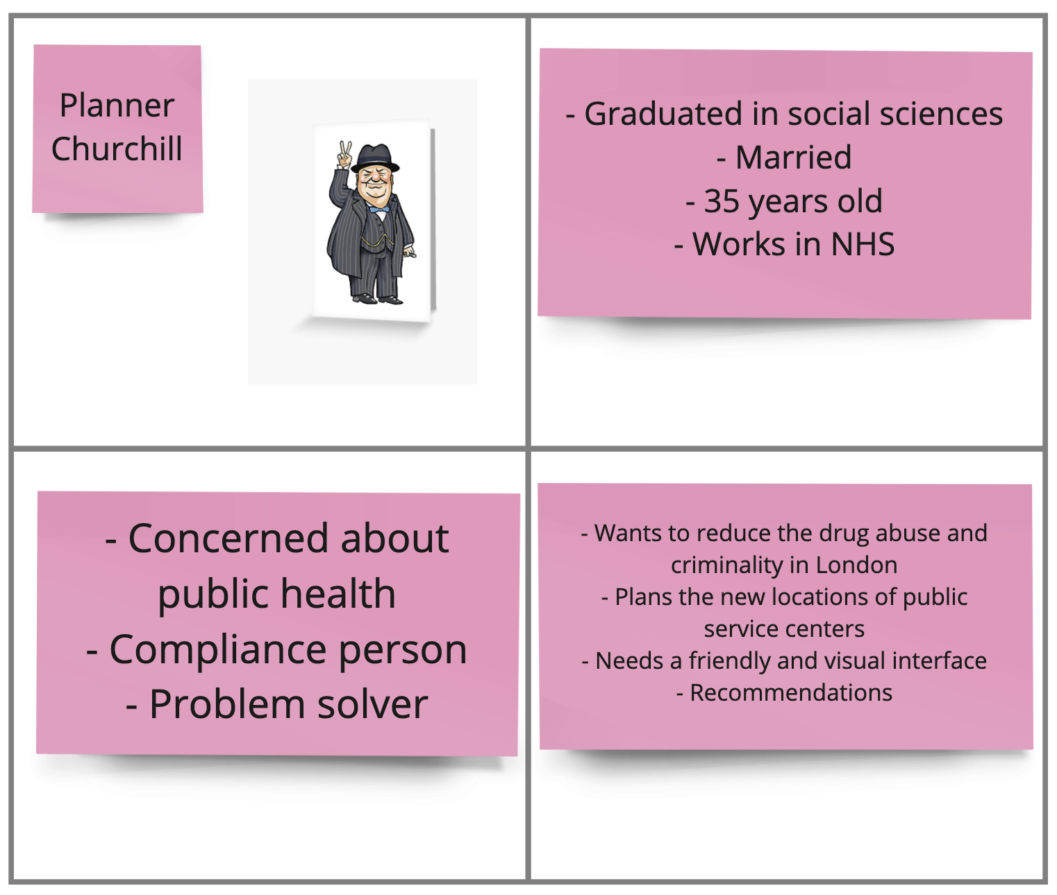
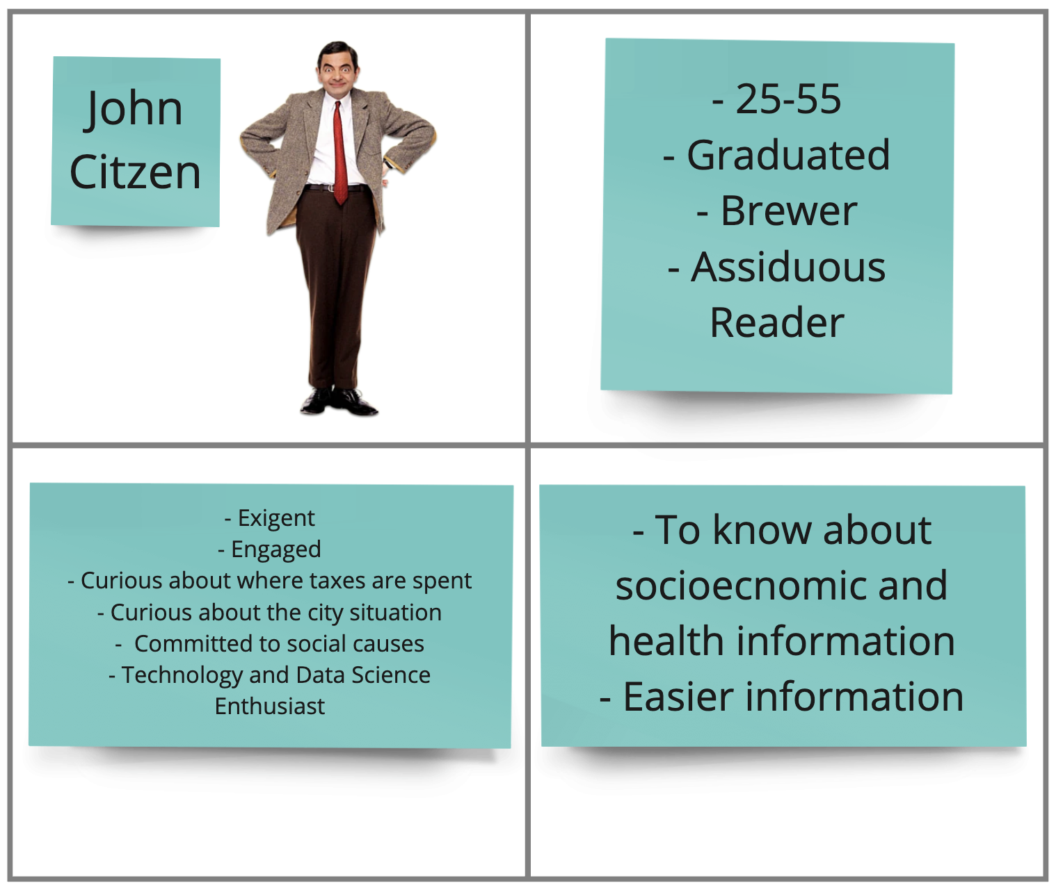
PERSONAS

Slide 6
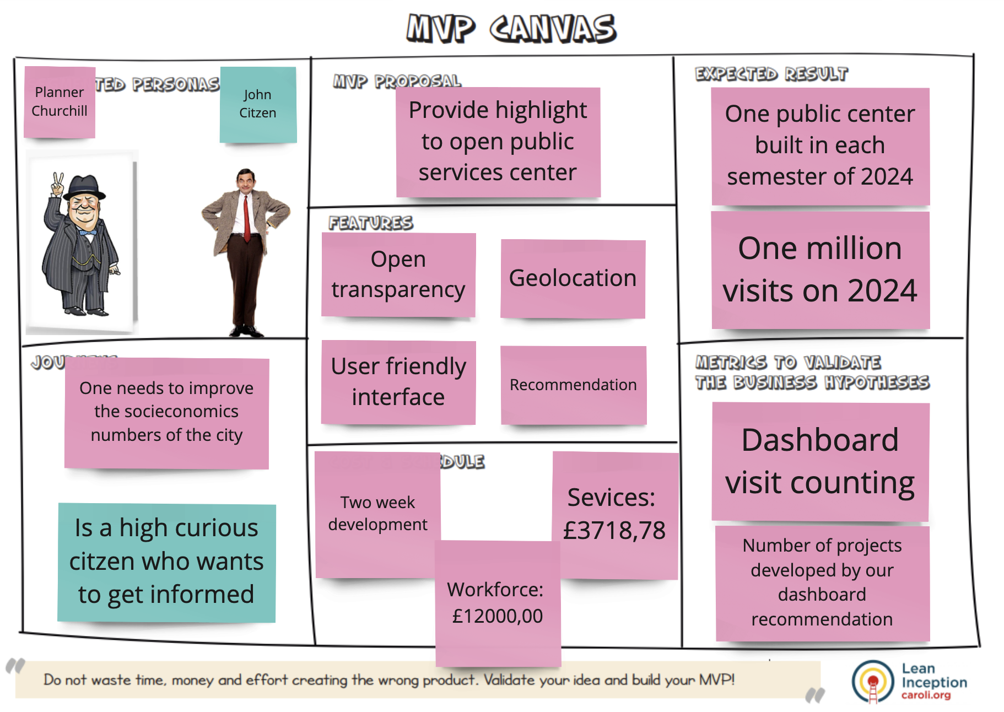
PROPOSAL

Slide 7
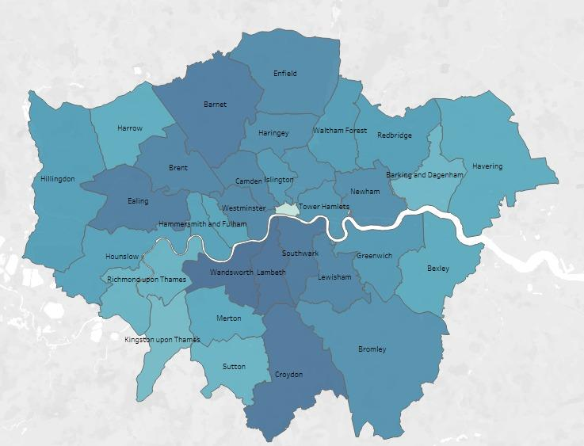
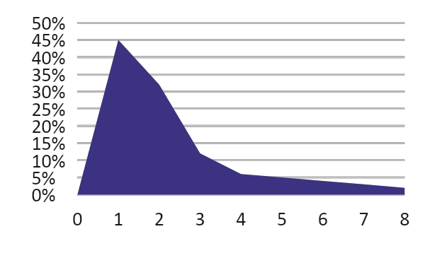
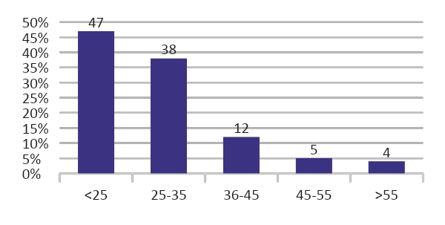

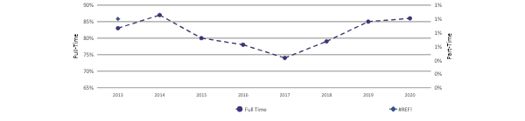
Healthcare Infrastructure Intelligence Dashboard
Filters
School classification
Criminality
School
classification
Criminality
Financial Security
Drug use
Financial Security
Drug use
Wellbeing per year

Slide 8
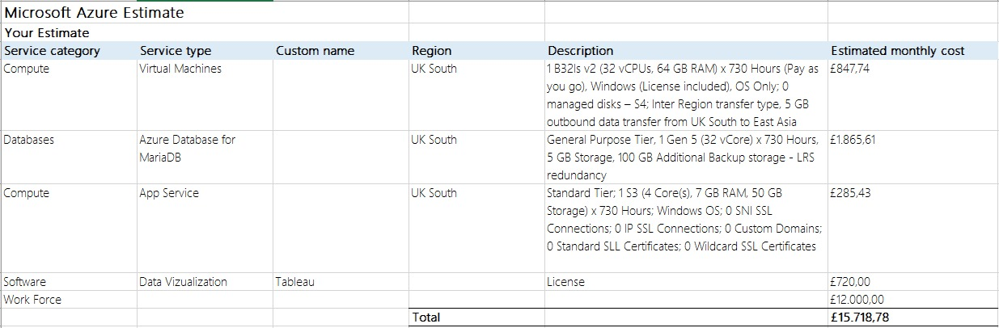
COSTS

Slide 9
Q
&
A
THANK YOU

